Slide 1
Learning Graph Representations at SCAle
Overview
21/8/2024

Slide 2
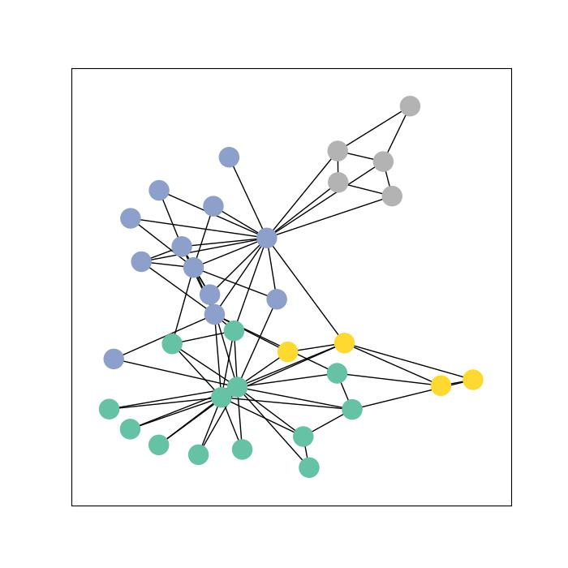
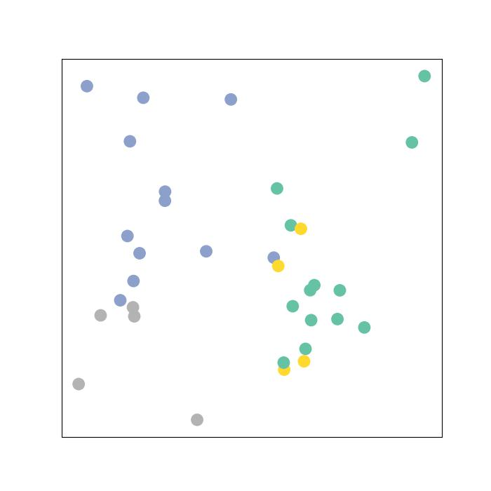
Graph embeddings
Graph Autoencoders and Graph Variational Autoencoders

Slide 3
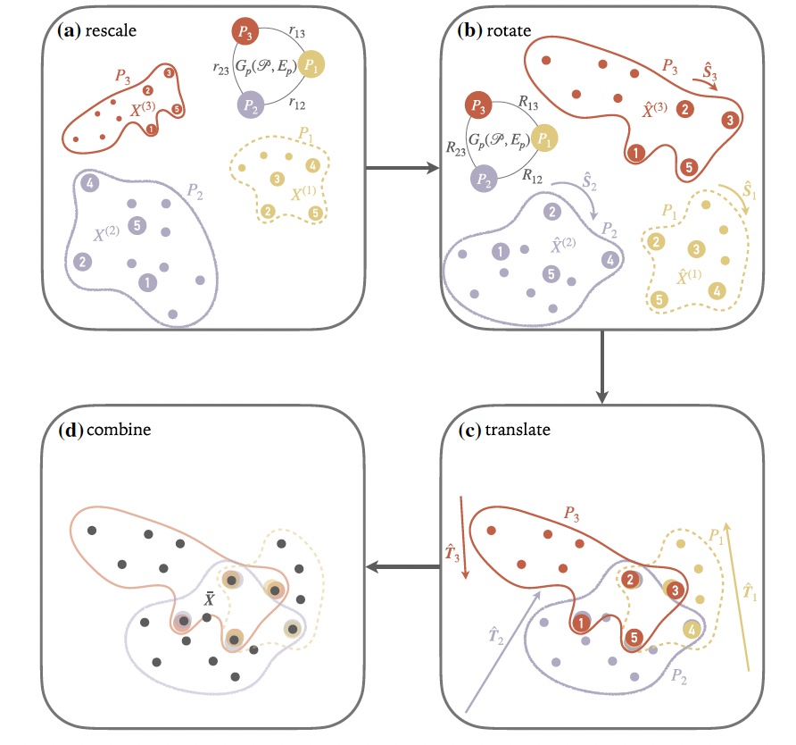
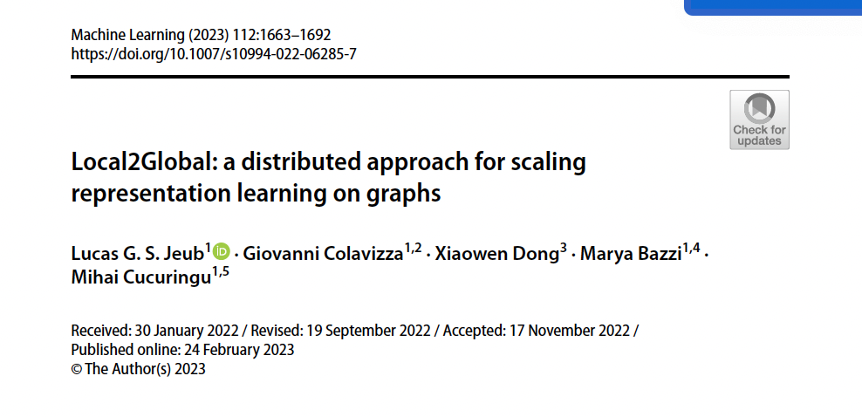
Local2Global
Graph embeddings by patch alignment

Slide 4
Anomaly detection
Temporal graphs
Network connectivity changes over time (autonomous systems data)
Financial networks
Cryptocurrency transactions
NFT networks
Detect scams such as wash trading or rug pulls from embeddings of temporal sequences of graphs

Slide 5
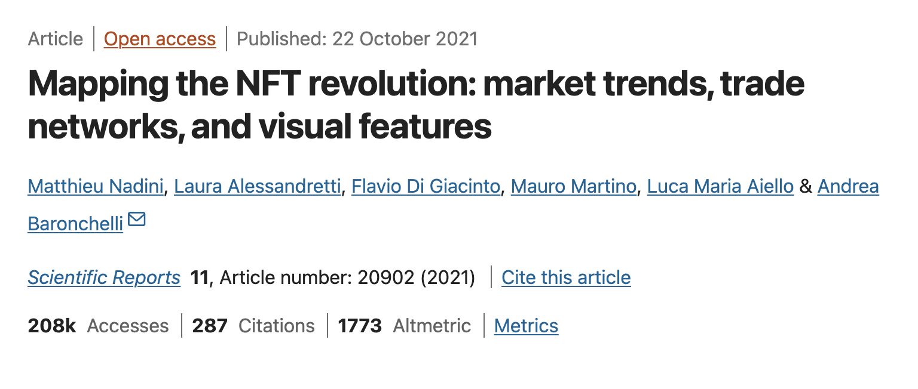
Data sets
Some of these have labels, some not (unsupervised problems)
Autonomous Systems (AS) https://snap.stanford.edu/data/as-733.html
Cryptocurrency transactions
Elliptic dataset
Elliptic2 dataset (50m nodes, 200m edges!)
Stablecoin ERC20 transactions https://snap.stanford.edu/data/ERC20-stablecoins.html
NFTs

Slide 6
An improved algorithm
Learn the alignments at the with the embeddings
The local2global method allows to scale embeddings of large temporal graphs but the synchronization step is still costly.
Instead of computing the individual embeddings and aligning them, a new approach will attempt to learn the alignment by optimizing a new cost function that incorporates the transformations that implement the alignment.

Slide 7
Tools
PyTorch and pytorch-geometric
Local2Global https://github.com/LJeub/Local2Global_embedding
Pometry / Raphtory
Dimensionality reduction and visualization (PCA, UMAP, etc)
Potentially: Rust for better performance (possibly with Python API)

Slide 8
Process / Timeline
https://
Stage 1
Stage 2
Stage 3
Stage 4
Interface / API for various datasets based on Raphtory.
Includes temporal graph analytics and visualisation.
Create interface for training graph embeddings using various methods, based on pytorch-geometric and (potentially) existing L2G code.
Optimize an implementation of the new algorithm.
Document package with example use cases as notebooks.

